Slide 1
Geometry & Mensuration
A
ABC is an isosceles triangle. If AB = AC = 73 and AD = 71(AD is any line). BD=32. Find CD.
Draw a ┴^{r} AE.
As ABC is a isosceles ∆, BE = EC.
From ∆ ABE, AE² =x² - BE ².
From ∆ AED, AE² =y² - ED ².
x²-BE ² =y²-ED ²
x²-y ² =BE²-ED ²
x²-y ²=(BE+ED)(BE-ED)
x²-y ²=(BE+ED)(CE-ED)
x²-y ² =(BD) (CD)
x²-y ² =αβ
x
x
y
B
E
D
C
BD =α
CD =β

Slide 2
Geometry & Mensuration
ABC is an isosceles triangle. If AB = AC = 16 and AD is any line and equals 12.How many triangles can be drawn such that such that BD & DC are integers?
BD*CD =16² – 12² =112
BD | CD | BD+DC
112 | 1 | 113 | Not possible
56 | 2 | 58 | Not possible
28 | 4 | 32 | Not possible
16 | 7 | 23 | Possible
14 | 8 | 22 | Possible
8 | 14 | 22 | Possible
7 | 16 | 23 | Possible
4 | 28 | 32 | Not possible
2 | 52 | 54 | Not possible
1 | 112 | 113 | Not possible
A
16
12
16
4 triangles can be drawn
B
D
C

Slide 3
Geometry & Mensuration
ABC is an isosceles triangle. If AB = ∆AC =5 and D & E trisect the BC. If BC = 9,find the sum of perimeters of ∆ABD, ∆ ADE & ∆ AEC
BE = ED = DC = 3
5² - AD² = 3 * 6
AD² = 25 – 18 = √ 7
5² - AE² = 3 * 6
AE² = 25 – 18 = √ 7
The answer is 19 + 4 √ 7
A
5
5
√ 7
√ 7
B
3
E
3
D
3
C
A
ABC is an isosceles triangle. If AB = ∆AC =5 and D & E are points on BC such that BE = 2,ED = 3, DC =4 ,find the sum of perimeters of ∆ABD, ∆ ADE & ∆ AEC
5² - AD² = 4 * 5 :: AD² = 25 – 20 = 5 :: AD = √ 5
5² - AE² = 2 *7 :: AE² = 25 – 14 = 11 :: AE = √11
The answer is 19 + 2 √ 11 + 2 √ 5
5
5
√ 5
√11
B
2
E
3
D
4
C

Slide 4
Geometry & Mensuration
A
ABC is a rt. Angled ∆
AB | BC | AC
3 | 4 | 5
5 | 12 | 13
7 | 24 | 25
9 | 40 | 41
8 | 15 | 17
12 | 35 | 37
20 | 21 | 29
B
C

Slide 5
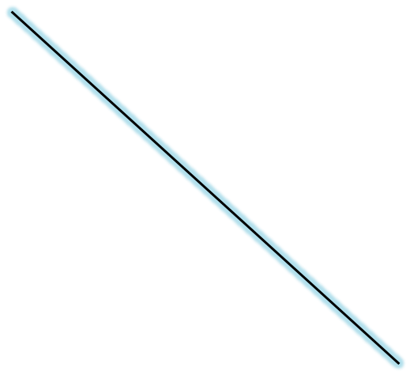
Geometry & Mensuration
AB is a tower of ht. 6.211. CD is a tower of ht. 2.263. BC is 5.264. Find AD
AE = 3.948.
ED = 5.264
AD² =AE²+ED²
AE =3*1.316.
ED =4*1.316
AD =5*1.316
A
6.580
3.948
┐
E
D
5.264
2.263
2.263
┐
B
5.264
C

Slide 6
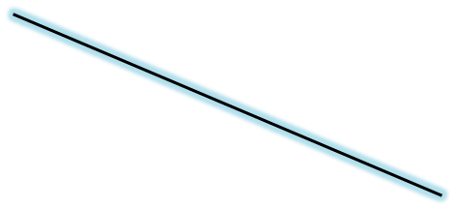
Geometry & Mensuration
A
In a rt. Angled Δ ABC, AC =68.
If perimeter of the triangle is 160 units, Find AB & BC.
AC = 4 *17 =68
AB = 4*8 = 32
BC = 4*15 = 60
68
32
┐
B
60
C
In the figure given alongside, AB is a diameter and is 65. BC= 39 and AD = 25. Find (AC) * (BD).
In Δ ACB, AB = 5*13 BC = 3*13 AC= 4*13
In Δ ADB, AB = 5*13 AD =5*5 AC= 5*12
(AC)*(BD) = 4*13*5*12 = 3120
D
C
A
B

Slide 7
Geometry & Mensuration
ABC is a right angled triangle. One of the sides is 17 and other sides are integers. Find the difference between Maximum area of such a triangle and minimum area of such a triangle.
Minimum area of such a triangle is possible when 17 is the hypotenuse .
The other sides are 8 & 15. Area is 60 sq. units.
Maximum area of such a triangle is possible when 17 is the minimum side.
The other sides are 144 & 145.
Area is 1224 sq. units.
Difference = 1164
A
17
8
B
15
C
A
145
17
B
144
C

Slide 8
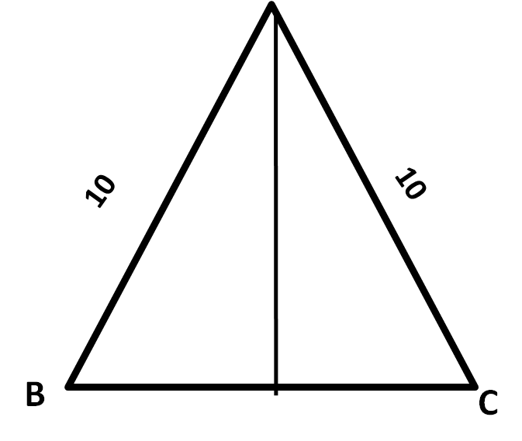
Geometry & Mensuration
A
ABC is an isosceles triangle. If AB = AC = 10.If the area is less than 48 sq. units, BC cannot take values in what range?
Let AD be the altitude.
Y=√100-x²
x √100-x² < 48
X²(100 - x²) < 48²
X⁴ – 100 x² + 48²>0
(X²–36) (X²–64)>0
X²<36 or X²>64
X<6 or X>8
BC<12 or BC>16
√100 - X²
x
D
x

Slide 9
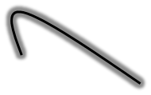
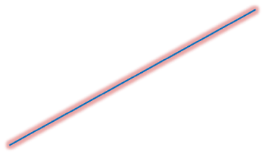
Geometry & Mensuration
In the figure below, S is the centre of the circle. PA and QB are altitudes to the sides QR and PR respectively of triangle PQR. Additional information from how many of the following statements is required and sufficient to find the value of PSQ?
  1.Value of AQS
  2.Value of ARB
  3.Lengths of QR and PR
(1) No additional information is required.
(2) Exactly one of the statements.
(3) Exactly two of the statements.
(4) All the three statements
S is circumcentre as well as orthocentre. It happens only in the case of Equilateral triangle. No further information needed
P
B
S
Q
A
R

Slide 10
Geometry & Mensuration
In the figure above, triangle ABC is a right-angled at B. Further, G and F are points on AC, while D and E are points on AB and BC respectively, such that DEFG is square. If DG=6cm, find the minimum possible length of AC.
(1) 19cm (2) 16cm (3) 20cm (4) 18cm (5) 14cm
In ∆ ABC, let ĹA=x. ĹC=90-x.
In ∆ DGA, ĹADG=90-x.
In ∆ EFC, ĹFEC=x.
∆ AGD III^{r} ∆ EFC
CF/DG = EF/AG
CF/6 = 6/AG
(AG) (CF) = 36.
For a given product of 2 numbers, sum of 2 numbers is minimum when they are equal. AG = CF = 6
AC = AG+GF+FC = 18
A
G
D
F
B
C
E

Slide 11
Geometry & Mensuration
A
Perimeter of a triangle is 24. Find the maximum area possible.
Area of Triangle = √{s(s-a) (s-b) (s-c)}
= √(12*3*4*5) =12√5
=26.83
9
7
B
8
C
Perimeter of a triangle is 24. Find the maximum area possible.
Area of Triangle = √{s(s-a) (s-b) (s-c)}
= √(12*3*3*6) =18√2
= 25.46
A
9
9
B
6
C
A
Perimeter of a triangle is 24. Find the maximum area possible.
Area of Triangle = ½ (6)(8) = 24
10
8
B
6
C

Slide 12
Geometry & Mensuration
A
Perimeter of a triangle is 24. Find the maximum area possible.
Area of Triangle = ^{√3}/₄{(8)²} = 16√3
= 27.71
8
8
B
8
C
Perimeter of a right angled triangle is 24. Find the maximum area possible.
X(2+√2) = 24
X = 24/(2+√2)
= 12(2-√2)
=7.03
Area = ½(X²)
= 24.71
A
x √2
x
B
x
C

Slide 13
Geometry & Mensuration
Perimeter of a triangle is 24. Find the maximum area possible.
Perimeter | Type | Area
24 | Equilateral | 27.71
24 | Scalene | 26.83
24 | Isosceles | 25.46
24 | Right Angle | 24.00
24 | Isosceles Right Angle | 24.71

Slide 14
GEOMETRY & MENSURATION
In ∆ ABC, AE = 12
AH:HD:: 2:3, BD:DC:: 3:4
Find EC.
Draw a line DF parallel to BE
∆ AHE |||^{r} ∆ ADF
^{AH}/_{HD} = ^{AE}/_{EF} = ²⁄₃
AE = 12 EF =18
∆ CFD |||^{r} ∆ CEB
^{CD}/_{BD}=^{CF}/_{EF}=⁴⁄₃
EF = 18 CF = 24
EC = EF+FC= 42
A
12
2
β
E
ø
α
18
H
β
F
ø
24
3
α
δ
δ
B
3
D
4
C

Slide 15
Geometry & Mensuration
In ∆ABC, BD = 12 ,
AE:EC:: 2:3,BH:HE:: 3:4. Find DC.
Draw a line EF parallel to AD
∆ BDH |||^{r} ∆ BFE
^{BD}/_{DF}=^{BH}/_{HE}=³⁄₄
BD = 12 DF =16
∆ CEF |||^{r} ∆ CAD
^{CF}/_{FD}=^{CE}/_{EA}=³⁄₂
DF = 16 CF = 24
DC = DF+FC= 40
A
ø
ø
2
2
E
E
4
4
H
H
β
ø
3
3
β
α
δ
α
δ
B
B
F
C
12
D
16
24

Slide 16
GEOMETRY & MENSURATION
In ∆ ABC, AE = 16,
AH:HD:: 4:5 BD:DC:: 3:4
Find EB.
Draw a line DF parallel to CE
∆ AEH |||^{r} ∆ ADF
^{AE}/_{EF}=^{AH}/_{HD}=⁴⁄₅
AE = 16 EF =20
∆ BFD |||^{r} ∆ BEC
^{BD}/_{DC}=^{BF}/_{FE}=³⁄₄
EF = 16 BF = 15
EB = EF+FB= 35
A
16
4
E
α
β
H
20
ø
F
α
5
15
ø
β
δ
δ
B
C
3
D
4

Slide 17
Geometry & Mensuration
In ∆ABC, CD = 25, CH:HE::5:7
AE:EB:: 5:2. Find BD.
Draw a line EF parallel to AD
∆ CHD |||^{r} ∆ CEF
^{CH}/_{HE}=^{CD}/_{DF}=⁵⁄₇
CD = 25 DF =35
∆BFE |||^{r} ∆ BDA
^{BF}/_{FD}=^{BE}/_{EA}=²⁄₅
DF = 35 BF = 14
BD = DF+FB= 49
A
ø
5
E
7
α
H
2
ø
α
5
δ
β
δ
β
B
14
35
C
F
D
25

Slide 18
Geometry & Mensuration
In ∆ ABC, BE =3,
BH:HD:: 1:4AD:DC:: 5:6,
Find EA.
Draw a line DF parallel to
CE
∆ BHE |||^{r} ∆ CDF
^{BH}/_{HD}=^{BE}/_{EF}=¹⁄₄
BE = 3 EF =12
∆ AFD |||^{r} ∆ AEB
^{AF}/_{FE}=^{AD}/_{DC}=⁵⁄₆
EF = 12 AF = 10
AE = AF+FE= 22
A
10
F
ø
5
12
β
δ
E
D
ø
α
β
4
6
3
α
H
1
δ
B
C

Slide 19
Geometry & Mensuration
In ∆ ABC, CD =6,
CH:HE::2:5,AE:EB:: 6:5
Find DA.
Draw a line EF parallel to
BD
∆ CHD |||^{r} ∆ CEF
^{CH}/_{HE}=^{CD}/_{DF}=²⁄₅
CD = 6 DF =15
∆ AFE |||^{r} ∆ ADB
^{AF}/_{FD}=^{AE}/_{EB}=⁵⁄₆
FD = 15 AF = 18
AE = AF+FE= 33
A
18
6
δ
F
α
15
E
ø
D
δ
β
α
5
6
5
β
H
ø
2
B
C

Slide 20
GEOMETRY & MENSURATION
In ∆ ABC, ĹB = 90.
AE bisects BD.BF =10.
AD:DC:: 4:5.Find FA.
Draw a line DG parallel to
CF
∆ BHF |||^{r} ∆ BDG
^{BH}/_{HD}=^{BF}/_{FG}=¹⁄₁
BF = 10 FG =1O
∆ AHD |||^{r} ∆ AFC
^{AG}/_{GF}=^{AD}/_{DC}=⁴⁄₅
FG = 10 GA = 8
AF = AG+GF= 18
A
8
4
10
D
F
1
5
H
10
1
B
C
E

Slide 21
GEOMETRY & MENSURATION
In triangle ABC, B=90° and BD is the altitude drawn from B to AC. If the area of triangle ABC is “x” sq.cm, the product (AD) (CD) cannot be
^{3x}/₄ (2) ^{11x}/₁₀ (3) ^{7x}/₈ (4) X (5) ^{5x}/₈
Area of right angled triangle is
Maximum when it is isosceles
triangle .
Let AB = BC = 2 k .
AD= √2k DC = √2K
In a right angled triangle ABC,
BD² = (AD)(CD)
(AD)(CD) = 2K²
Area of triangle = 2K²= X
Area of triangle = (AD)x(CD).
Max {(AD)(CD)} is X
Therefore (AD)(CD) cannot be 11x/10
A
K√2
2K
D
K√2
B
2K
C

Slide 22
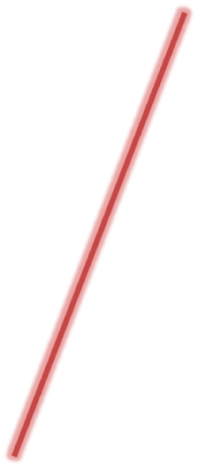
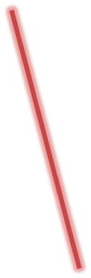
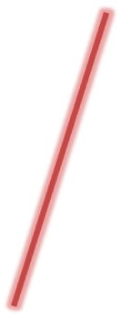
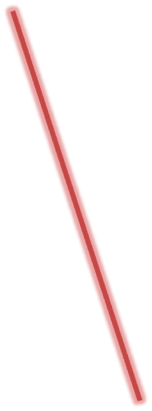
GEOMETRY & MENSURATION
A
D
In the figure given alongside(not drawn to scale), ABCDE is a concave pentagon with B=60°. AB =12cm, E=300° and Area of the pentagon =56√3sq.cm.If the pentagon is symmetric about the line l (show as Dotted line), drawn ┴r to BC and passing through E, find the length BC.
(1)18 (2)16 (3) 20 (4) 24 (5) 15
60
60
12
300
Extend AE to G and let us extend DE to F.
∆ ABG is Equilateral ∆ :: ∆ABG = 36√3
∆ DCF is Equilateral ∆ :: ∆ DCF = 36√3
∆ FEG is Equilateral ∆
∆ FEG= ∆ ABG+ ∆ DCF- ABCDE
FEG = 16√3 . FG = 8
BG = CF = 12
BC = 12+12 – 8 = 16
60
60
60
B
60
F
G
C

Slide 23
GEOMETRY & MENSURATION
A man standing on a horizontal plane observes the angle of elevation of a tower to be α. After walking a distance equal to double the height of the tower, he observes the angle of elevation to be 2α. Then α is (1) π/₂ (2) π/₆ (3) π/₁₂ (4) π/₁₈
A
Let AB be the tower.
Let AB = h. CD = 2h
Ĺ BAC = 90 - α
Ĺ BAD = 90 - 2α
Ĺ DAC = α
AD = DC = 2h.
∆ ABD, Sin2α =½
2α =30 :: α =15
α = π/₁₂
α
h
2h
2α
α
B
D
2h
C

Slide 24
GEOMETRY & MENSURATION
ABCD is a cyclic quadrilateral of area 4√3. If AB = 2, BC = 5 and ĹB = π/₃ , its perimeter is : (1) 8 (2) 10 (3) 12 ( 4) 14
∆ ABC = ½{2*5}Sinπ/₃ = 5√3 /2
∆ ADC =½{X*Y} Sin2π/₃=3√3/2
XY = 6
Cos60={2²+ 5² -Z²}/20 = ½
Z² = 19
{X²+y² - Z²}/ 2xy =Cos 120=-½
X²+y² = 13. XY = 6
X = 2 & Y=3
Perimeter = 12
2
A
B
π/₃
X
5
Z
2π/₃
D
C
Y

Slide 25
GEOMETRY & MENSURATION
ABC is an isosceles right angled triangle right angled at B. D is a point on AB such that ĹDCB=15⁰. If AD = 35√2 find DC.
(1) 60√2 ( 2) 70 ( 3) 72 (4) 74
In ∆ ADC,
^{AD}/Sin 30⁰ = ^{DC}/Sin 45⁰
^{35√2}/_{1/2} = ^{DC}/_{1/√2} =
70√2 = √2 DC
DC = 70
A
45⁰
35√2
D
70
30⁰
15⁰
B
C

Slide 26
GEOMETRY & MENSURATION
ABC is an isosceles triangle such that AB = AC . D is a point on BC such that ĹABD=40⁰. E is a point on AC such that AD = AE. Find ĹEDC.
(1) 35 ( 2) 20 ( 3) 15 (4) 20
Let ĹABD=ĹACD = 2y^{0.}
Then ĹDAE = 140⁰ – 4y
ĹDAE=ĹDEA = 20⁰+ 2y⁰
ĹDAE = 160⁰ – 2y.
From ∆ EDC , ĹEDC = 20⁰
A
140 – 4y
40
E
20+2y
160-2y
20+2y
2y
20
2y
B
C
D

Slide 27
GEOMETRY & MENSURATION
ABC is an isosceles triangle such that AB = AC . D is a point on BC such that ĹABD=50⁰. E is a point on AC such that AD = AE. Find ĹEDC.
(1) 35 ( 2) 20 ( 3) 15 (4) 25
Let ĹABD=ĹACD = 2y^{0.}
Then ĹDAE = 130⁰ – 4y
ĹDAE=ĹDEA = 25⁰+ 2y⁰
ĹDAE = 155⁰ – 2y.
From ∆ EDC , ĹEDC = 25⁰
A
130 – 4y
50
E
25+2y
155-2y
25+2y
2y
25
2y
B
C
D

Slide 28
GEOMETRY & MENSURATION
P is a internal point of ABC, AP, BP, CP when produced
meets the sides at D, E & F respectively. If BD=2DC &
AE= 3EC , Find AP:PD
A
Draw a line DG parallel to BE
∆ CGD |||^{r} ∆ CEB
^{BD}/_{DC} = ^{EG}/_{GC} = ²⁄₁
Let CG=α :GE=2α:CE=3α
AE = 3EC: AE = 9α
∆ APE |||^{r} ∆ ADG
^{AE}/_{EG}= ^{AP}/_{PD} =⁹⁄₂
9α
9n
E
β
P
ø
2α
α
G
β
2n
ø
α
α
B
δ
δ
D
C
2
1

Slide 29
Geometry & Mensuration
If D, E, F are the points of contact of the in circle of a triangle ABC with its sides what is the ratio of Area of triangle DEF to area of the triangle ABC?
A
Δ FID = ½ r² Sin FID = ½ r² Sin B
Δ EID = ½ r² Sin EID = ½ r² Sin C
Δ FIE = ½ r² Sin FIE = ½ r² Sin A
Δ DEF=½ r²[ Sin A + Sin B+ Sin C]
F
E
From triangle ABC,
^{A}/_{Sin A} = ^{B}/_{Sin B} = ^{C}/_{Sin C} = 2R
[Sin A + Sin B+ Sin C]= ^{[a +b + c]}/_{2R}= ^{s}/_{R}
I
Δ DEF=½ [r²][^{s}/_{R}]
=½ [r][^{rs}/_{R}]
rs= Δ ABC
Δ DEF / Δ ABC = [r/_{2R}]
B
D
c

Slide 30
Geometry & Mensuration
In a ∆ ABC, ĹB=90◦. AD(Median)=3.CF(Median)=4.
Find area of ∆ ABC
Let BD = y = DC
Let AF = x = FD
∆ ABC = ¹/₂(2X)(2Y) = 2XY
From ∆ FBC, X² + 4Y² = 16
From ∆ ABD,4X² + Y² = 9
Adding the 2 equations,
X² + Y² = 5
3 Y² = 11 :: Y = √[¹¹/₃]
3 X² = 4 :: X = ²/_{√3}
∆ ABC = 2XY
= 4 √¹¹/₃
.
A
x
F
4
x
3
B
y
D
y
C

Slide 31
Geometry & Mensuration
In a right angled ABC, ĹB=90◦; AB = a , BC = b (a<b). All sides are integers. If perimeter of ABC is equal to area of ABC, how many values (a, b) can take?
a + b+√a²+b² =¹/₂ (a b)
2a+2b+2 √a²+b²= a b
2a+2b-ab=-2√a²+b²
4a² +4b² +a²b² +8ab-4ab² -4a²b=4(a²+b²)
4a² +4b² +a²b² +8ab-4ab² -4a²b=4a²+4b²
ab+8-4b-4a=0
ab-4a-4b+8=0
ab-4a-4b+16-16+8=0
(a-4)(b-4)=8
A
√a²+b²
a
a | b | √a²+b² | Peri
6 | 8 | 10 | 24
5 | 12 | 13 | 30
B
b
C

Slide 32
Geometry & Mensuration
D
ABC is an equilateral triangle. CDE is an isosceles triangle. CD = DE . Area of Δ ABC = Area of ΔCDE . If BC = 2CE, what is the ratio of Perimeter of ΔABC & perimeter of ΔCDE
A
7k
4k
7k
4k
2√3k
4√3k
Let BC = 4k
CE = 2k.
Let AF & DG be ┴rs
AF = ^{√3}/₂ (4k) = 2√3k
DG = 2AF = 4√3k
CD = DG² + CG² = 7k
Perimeter of ABC = 12 k
Perimeter of CDE = 16k
Reqd ratio = 3/4
B
F
C
G
E
4k
2k

Slide 33
GEOMETRY & MENSURATION
P is a internal point of ABC, AP, BP, CP when produced meets the sides at D, E & F respectively. If BD = 2DC and AE = 3EC then, Find BP:PE
A
ø
3
E
Draw a line EG parallel To AD
∆ CEG |||^{r} ∆ CAD
^{CE}/_{EA} = ^{CG}/_{GD} = ¹⁄₃
Let CG=α :: GD=3α :: CD=4α
BD = 2DC :: BD = 8α
∆BPD |||^{r} ∆ BEG
^{BD}/_{DG} = ^{BP}/_{PE} = ⁸⁄₃
P
3n
β
ø
1
8n
β
α
δ
α
δ
B
8α
3α
C
D
G
α

Slide 34
GEOMETRY & MENSURATION
P is a internal point of ∆ABC, AP, BP, CP when produced meets the sides at
D, E & F respectively. If BD = 2DC and AE = 3EC then, Find CP:PF
A
Draw a line FG parallel To AD. To Find ^{CP}/_{PF}, we
Need to find out ^{CD}/_{DG .} To Find ^{CD}/_{DG} , we
Need to find out ^{BG}/_{GD}
F
P
B
G
D
C
A
Draw a line DH parallel To CF
∆AFP |||^{r} ∆AHD ::: ^{AP}/_{PD} = ^{AF}/_{FH} = ⁹/₂
∆BHD |||^{r} ∆ BFC ^{::: BD}/_{DC} = ^{FH}/_{HB} = ²/₁
^{BF}/_{FA} = ⁶/₉ = ²/₃
9
F
2
P
H
A
4
B
2
D
1
C
Draw a line DH parallel To FH. ∆BFH |||^{r} ∆BAD
^{BF}/_{FA} = ^{BH}/_{HD} = ²/₃ BD = 5 CD = 5/2
^{CD}/_{DH} = ⁵/₆ ∆ CPD |||^{r} ∆CFH
^{CP}/_{PF} = ^{CD}/_{DH} = ⁵/₆
3
F
P
2
B
2
H
3
D
⁵/₂
C

Slide 35
Geometry & Mensuration
Area of Quadrilateral ABCD
= Area of ∆ABC
+ Area of ∆ADC
Let BE & DF be ┴rs
from B to AC
& from D to Ac
Area of ∆ABC= ½ (BE )(AC)
Area of ∆ADC= ½ (DF )(AC)
Area of Quadrilateral ABCD
= ½ (BE + DF) AC
BE & DF are called offsets
B
C
A
F
E
D

Slide 36
Geometry & Mensuration
Cyclic Quadrilaterals
In a cyclic quadrilateral, opposite angles add up to 180⁰.
ĹB + ĹD = ĹA + ĹC = 180^{0.}
ABCD lie on the Circumference of a Circle . ABCD are con-cyclic.
Con-cyclic means these points lie on a circle.
Area of a Cyclic Quadrilateral = √ (s - a) (s - b) (s - c) (s - d)
s = ^{(a + b + c + d)}/₂
Let AC = d₁
BD = d₂
d₁ d₂ = ( ac + bd )
B
b
a
E
C
A
C
d
D

Slide 37
Geometry & Mensuration
B
110⁰
40⁰
C
90⁰
30⁰
70⁰
20⁰
D
A
In the given figure, AD is a diameter. ∠ BAC = 30⁰. ∠ ADC = 70⁰. Find ∠ BCD & ∠ ABC.
In ∆ ACD , ∠ ACD = 90⁰ and ∠ CAD = 20⁰.
ABCD is a cyclic quadrilateral . Hence ∠ ACD = 130⁰ and ∠ BCA = 40^{0 .} From ∆ ABC, ∠ CBA = 110⁰

Slide 38
Geometry & Mensuration
In the figure below, chord BC is parallel to the diameter DE of the circle. If ∠BAC = 40º, find ∠EBC.
40º (2) 30º (3) 50º
(4) 25º (5) 32.5º
B
ǿ
C
90⁰
40⁰
ǿ
∠BAC = ∠BEC = 40º
(as angles in the same
segment are equal.
∠CBE = ∠BED = ǿ
∠DBE = 90⁰
90 + ǿ + 40 + ǿ = 180⁰
ǿ = 25⁰
D
E
40⁰
A

Slide 39
Geometry & Mensuration
In the figure below, o is the centre and PT is the diameter. Angle ĽRST = 140^{0,} Then Angle ĽPQR is ------ given that PQ = QR.
40º (2) 140º (3) 135º (4) 130º
150º
Ľ PQT = 90⁰ (Angle in semi circle )
QRST is a cyclic Quadrilateral
and therefore Ľ TQR = 40⁰
Ľ PQR = Ľ PQT + Ľ TQR
= 90 ⁰ + 40 ⁰
= 130 ⁰
R
Q
40⁰
S
90⁰
140⁰
P
0
T

Slide 40
Geometry & Mensuration
In the figure below, o is the centre and PS is the diameter. QR is parallel to PS. If PS = 65 , PQ= 25 & RS = 39, find QR.
(1) 31 (2) 32 (3) 33 (4) 20 (5) 35
Ľ PQS = 90⁰ (Angle in semi circle )
QS² = PS² - PQ²
= 65² – 25² = 3600
QS = 60
Ľ PRS = 90⁰ (Angle in semi circle )
PR² = PS² - RS²
= 65² – 39² = 104*26 = 52*52
PR = 52
In a cyclic quadrilateral ,
PS * QR +PQ*RS = PR*QS
65 * QR +25*39 = 60*52
QR = 33 Units.
Q
R
S
P
0

Slide 41
Geometry & Mensuration
ABCD is a trapezium where BC is parallel to AD.
Let AD=p₁
BC=p₂
AB = n₁
CD = n_{2.}
Area of ABCD = ½(p₁+ p₂)h
B
C
h
A
D
ABCD is a trapezium where BC is parallel to AD. Let AC & BD be the diagonals. Then ∆ BEC and ∆ DEA are similar because
Ľ EAD = Ľ ECB . :: Ľ EDA = Ľ EBC. Third angle should be equal. Therefore ^{AE}/_{CE} = ^{DE}/_{BE} = ^{AD}/_{BC}
B
C
E
A
D

Slide 42
Geometry & Mensuration
ABCD is a trapezium where CD is parallel to AB. EF divides DA & CB in the ratio 2:3. If AB = 20 & CD = 10 what is EF.
Let us draw DG & CH perpendiculars to AB.
▲DEJ and ▲DAG are Similar
^{DE}/_{DA}=^{DJ}/_{DG} =^{EJ}/_{AG} =²/₅
▲CFK and ▲DBH are Similar
^{CF}/_{CB}=^{CK}/_{CH} =^{K}/_{BH} =²/₅
EF =CD + 2/5 [AB – CD]
= 10+ ²/₅[10]
= 14
D
C
E
F
J
K
A
B
G
H

Slide 43
Geometry & Mensuration
ABCD is a trapezium where BC is parallel to AD. Let AD=p₁, BC=p_{2,}AB = n₁ & CD = n_{2.} Find sum of squares of Diagonals.
Let us draw BG & CH perpendiculars to AB.
▲BAG, bg
Let AC=d₁, BD=d₂
d₁² + d₂² = n₁² + n₂² + 2p₁p₂
B
C
F
A
D
G
H
B
C
E
A
D

Slide 44
Geometry & Mensuration
ABCD is a trapezium where BC is parallel to AD. AD=16, BC=14, AB =10 & CD =15.Find the sum of squares of diagonals.
B
C
If AD=p₁, BC=p_{2,}AB = n₁ & CD = n_{2.}
d₁² + d₂² = 10² + 15² + 2(16)(14)
= 325 + 448
= 773 Sq. units.
A
D
B
C
ABCD is a trapezium where BC is parallel to AD.
Let AD=p₁, BC=p_{2,}AB = CD = n. Then
the trapezium is called isosceles
trapezium.
Any trapezium inscribed in a circle
is an isosceles trapezium which
means non parallel sides are equal.
A
D

Slide 45
Geometry & Mensuration
ABCD is a parallelogram where AB is parallel to CD and AD is parallel to BC. Adjacent angles add up to 180⁰
Ľ A +Ľ B = 180⁰.
Ľ B +Ľ C = 180⁰.
Ľ C +Ľ D = 180⁰
Ľ D +Ľ A = 180⁰.
Diagonals bisect each other.
Let AB = CD = a and BC = AD = b
Area of Parallelogram ABCD = a p_{a} Area of Parallelogram ABCD = b p_{b}
Area of Parallelogram ABCD
= a b SinѲ ,
where Ѳ is the angle between any two adjacent lines.
A
a
B
b
p_{a}
b
a
D
C
A
a
B
b
b
Ѳ
a
D
C

Slide 46
Geometry & Mensuration
If a parallelogram ABCD is inscribed in a circle, then the parallelogram becomes a rectangle.
By definition, adjacent angles add up to 180⁰
Ľ A +Ľ B = 180⁰. ………….(1)
Ľ B +Ľ C = 180⁰. ………….(2)
Ľ C +Ľ D = 180⁰
Ľ D +Ľ A = 180⁰.
Because ABCD is a cyclic Quadrilateral, ĽA+ĽC=180⁰. ………….(3)
From (2)&(3), ĽA- ĽB= 0⁰ ……….(4)
From (1) & (4) , Ľ A = Ľ B= 90⁰
Similarly , Ľ C = Ľ D= 90⁰
A
a
B
b
b
a
D
C
A
a
B
b
b
Ѳ
a
D
C

Slide 47
Geometry & Mensuration
ABCD is a parallelogram where AB is parallel to CD and AD is parallel to BC. BC = 8 CD = 10 and BD =14. Find AC.
Let us join AC.
In a parallelogram, Diagonals bisect each other. BE = ED = 7.
In ∆ BDC, CE is a median. By the property of Median ,
BC²+CD² = 2 (CE²+ED²)
8²+10² = 2 (CE²+7²)
164 = 2(CE²+49)
33 = CE²
CE = √33 :: AC = 2 √33
A
10
B
8
E
8
D
10
C

Slide 48
Geometry & Mensuration
ABCD is a parallelogram where AB is parallel to CD and AD is parallel to BC. ĽDAC = 40⁰ . ĽBCM = 30⁰ .CD = 2 AD. Find ĽMEC
A
M
B
Since CD = 2 AD, MB = BC and AD = MA.
∆MBC is isosceles triangle. ĽBMC = 30⁰ :: ĽMBC = 120⁰.
20⁰
60⁰
30⁰
120
40⁰
90⁰
E
80⁰
60⁰
10⁰
30⁰
D
C
From parallelogram ABCD , ĽDAM = 60⁰ :: ĽCAM = 20⁰
∆DAM is an equilateral isosceles triangle. ĽAMD = 60⁰
ĽAMD = 60⁰.
ĽEMC = 90⁰.
ĽMEC = 80⁰

Slide 49
Geometry & Mensuration
ABCD is a parallelogram where AB is parallel to CD and AD is parallel to BC. ĽDAC = 40⁰ . ĽBCM = 30⁰ .CD = 2 AD. Find ĽMEC
A
M
B
Let N be the midpoint of CD. Let us join MN.MN will be parallel to AD & BC and its length will be equal to AD. Therefore all line segments DN = DA = AM = MB = BC = CN = r
40⁰
90⁰
E
80⁰
10⁰
30⁰
D
C
N
With N as a centre and radius equal to r , if a circle is drawn it will pass through, it will pass through M. Therefore ĽDMC = 90⁰.From ∆ EMC, ĽMEC = 80⁰

Slide 50
Geometry & Mensuration
ABCD is a parallelogram. M is the mid-point of BC. DM is extended to meet AB produced at E. If DL = 6 . What is LE ?
Ľ MDC = Ľ MBE
Ľ DMC = Ľ BME
MC = MB
∆ DMC & ∆ BME are congruent.
DM = ME. In ∆ DMC, CN is median and DM is median and therefore L is centroid.
LM = 3.
DM = 9.
ME = 9.
LE = 12
B
E
A
N
L
M
D
C

Slide 51
Geometry & Mensuration
ABCD is a parallelogram. M is the mid-point of AB. N is the mid-point of CD. Join DM, BN & AC. Let the point of intersection of AC & DM be X and intersection of AC & BN be Y.
K₁=^{AX}/_{XY ,} K₂=^{CY}/_{XY ,} K₃=^{AX}/_{CY}
What is the value of K₁ + K₂ + K₃?
Join BD. Let the point of intersection of AC & BD be O. AO = OC.
From ∆ BAD , X is centroid as AO is median and DM is also median. AX = 2 XO.
A
M
B
X
y
D
N
C

Slide 52
Geometry & Mensuration
ABCD is a parallelogram where BC = 8 CD = 10 and Ľ DAB = 60⁰ . Find area of parallelogram ABCD.
Area of parallelogram ABCD
= 8*10*Sin 60⁰= 40√3
B
C
A
D
ABCD is a parallelogram inscribed in a circle,where BC = 8 CD = 10 . Find area of parallelogram ABCD.
Parallelogram inscribed in a circle is a rectangle.
Area of parallelogram ABCD
= 6*8= 48
B
C
A
D

